Slide 1
Android Code Quality Assessment
Bench Marking Legacy code with Current
Industry Standards
Anup | Anvesh | Anju | Karthik
Android Dev Team - InStock Moment

Slide 2
Dev Team’s work on Setup and Code Familiarization
Code quality assessment for eTransfer and RemoveFromInventory capabilities of the InStock Moment Android Application.
Code setup as per Previous Dev team’s ADVICE.
GIT SETUP and COMMIT / PUSH using SSH public key ,as per KROGER’s internally proven and currently in-use recommendations.
Familiarization with SonarCUBE , which was already setup to EXECUTE in CI runners after each successful PUSH to the remote.
Attempt to understand existing BUSINESS LOGIC Tests , and add to extend UI automated Tests as per Android Standards.
Successful COMPILE, BUILD , EXECUTE , DEPLOY (on VDI Emulator) of the capabilities as Stand alone app ,and generate SonarCUBE reports on virtual dashboard.

Slide 3
Observations on Legacy Code base Pattern and Architecture
Android Code base for both eTransfer and RemoveFromInventory capabilities Utilize MVP ( MODEL VIEW PRESENTER ) type architecture.
All the code flow is User/Event driven. Hence business logic in the presenters are tightly coupled with the UI/Views (activities) via Contract interfaces.
Extensive usage of Activity as their main VIEW component.
100% usage of Java1.8 as their primary coding platform.
Usage of AsyncTask Component to perform network on worker thread. ( to avoid Network on main thread Exception)
Confined to the use of Okhttp as their go-to library for all network related activity ( reason being use of custom Interceptors at IN-STOCK level).
Fair usage of Testing Libraries: MOKITO was used for testing functional code.
Current test coverage stands at ~53% ( with NO UI tests).

Slide 4
Dev Teams Recommendations
Android Code base for both eTransfer and RemoveFromInventory have to be moved to MVVM Architecture.
Usage of Fragment -ViewModel Type components that separate Business Logic from UI in a seem-less manner ( using LiveData Library)
Move to KOTLIN , with unlimited advantages and on Google’s recommendations.
Discontinue the usage of AsyncTask Component to perform network on worker thread and switch to Kotlin’s Co-Routines
Expands the apps Reactive nature by replacing to the use of Okhttp with RxJava/RxKotlin without disturbing existing custom interceptors at IN-STOCK level.
Reach the set standard of 85% of test coverage by adding Espresso and Unit testing.

Slide 5
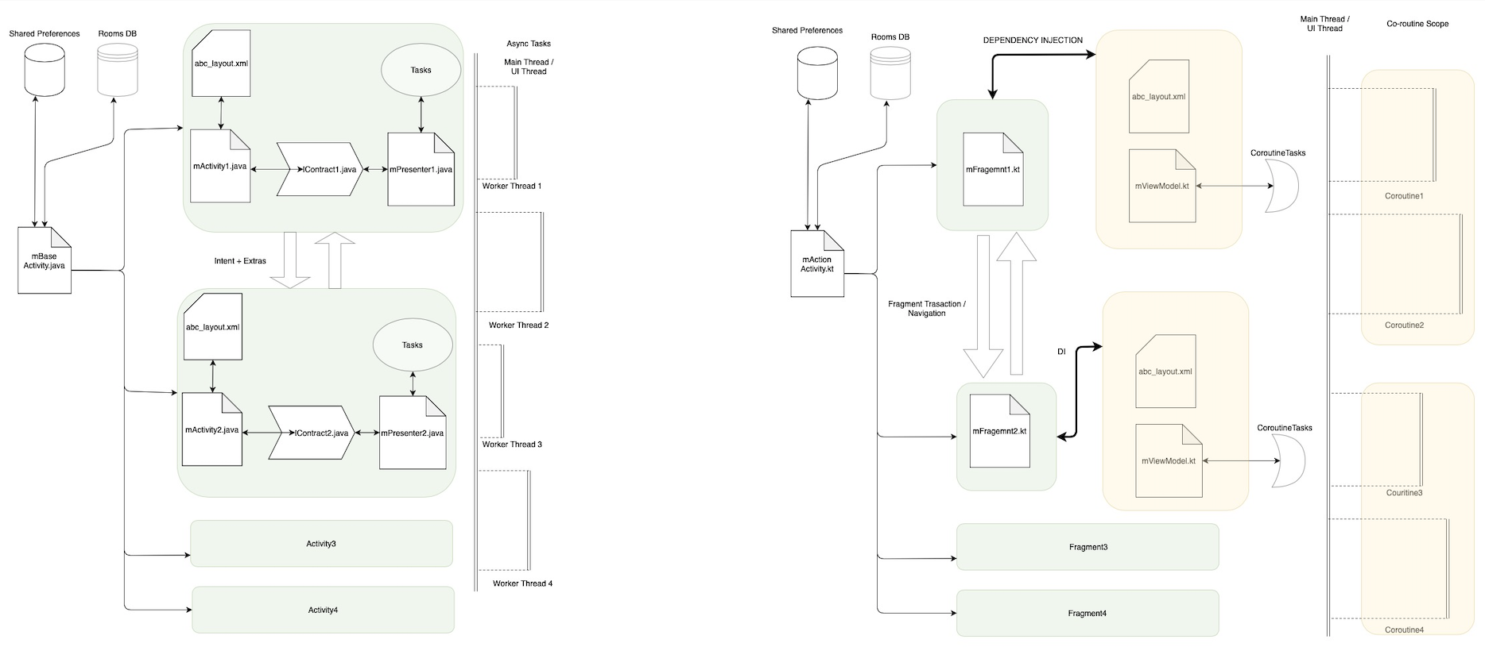
Transition Plan from Legacy code’s Current Architecture yo Dev teams recommendations ( TWO STEP PROCESS)
STEP ONE : MVP to MVVM
JAVA-MVP on the LEFT (LEGACY) vs KOTLIN-MVVM on the RIGHT

Slide 6
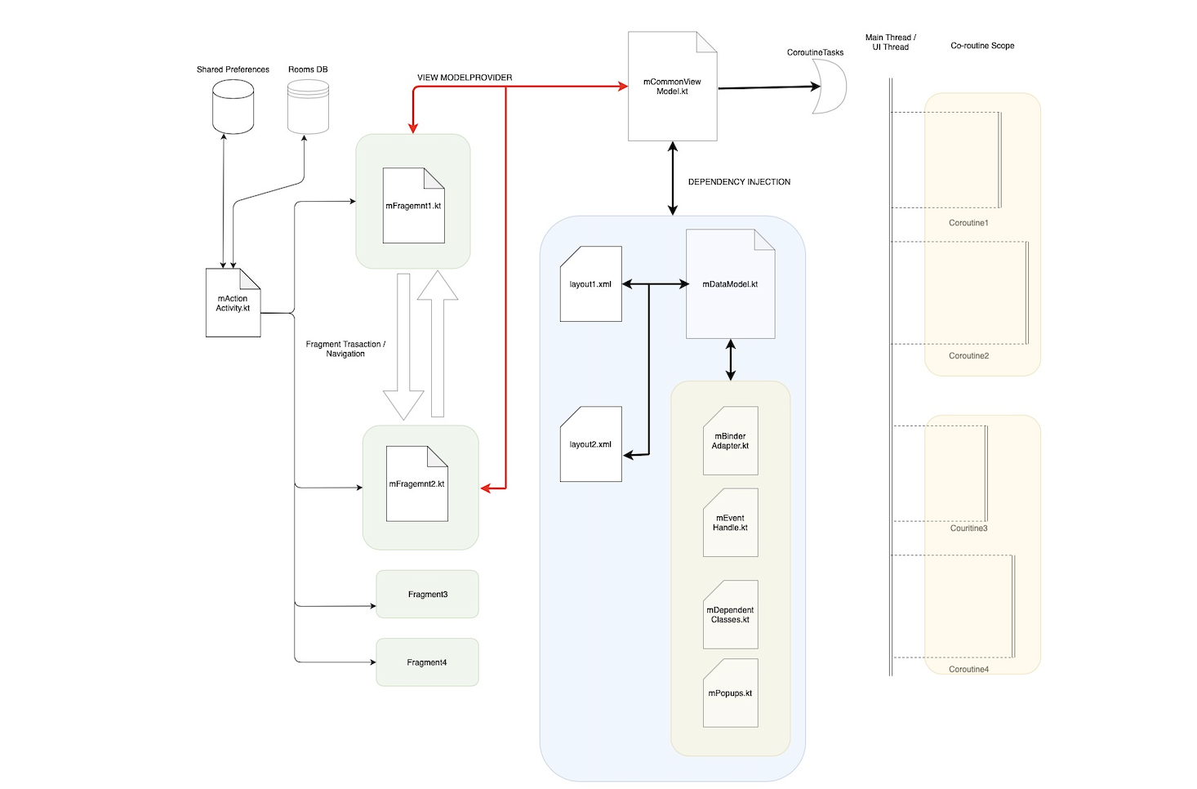
STEP 2 : ViewModel - DataModel using DataBinding
High Quality High Fidelity Reactive Apps
Seems Less integration into future components like KDS artifacts
DATA driven NOT USER/EVENT driven.
100% future support from Google.
Reactive Architecture using DataBinding

Slide 7
Quality and Performance Aspiration SET at :
THE END

